Slide 1
PROJECT REPORT
Sales Performance
Analysis
A Power BI dashboard review of sales, profitability and customer
segment performance — with insights and recommendations.
Prepared by Pranay • Data Analytics Project

Slide 2
EXECUTIVE SUMMARY
The Business at a Glance
Across all segments, the company generated $118.73M in total sales at a 14.23% profit margin. The numbers below summarise overall performance before the segment-level insights that follow.
🛒
💲
➕
%
U
700
$118.73M
$16.89M
14.23%
1M
Total Orders
Total Sales
Total Profit
Profit Margin
Units Sold
02

Slide 3
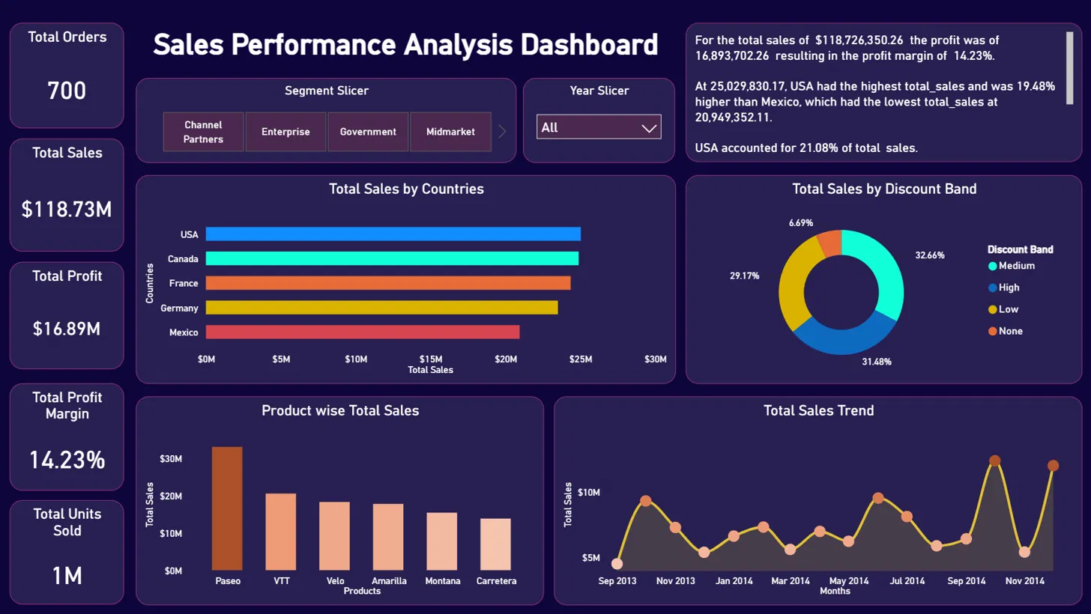
THE DASHBOARD
Dashboard at a Glance
Built in Power BI, the dashboard lets viewers slice sales by customer segment and year, then explore performance by country, discount band, product and month.
03

Slide 4
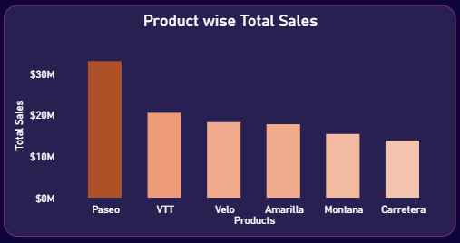
INSIGHT 01
Paseo, VTT and Velo Lead Every Market
Consistent leaders across every country
Paseo, VTT and Velo are the top-selling products in every country covered by the dashboard, not just on average — the same three products lead the ranking wherever you look.
What this means
Paseo alone sells roughly 50% more than the next-closest product, making it the clear flagship item. Montana and Carretera consistently trail behind, indicating room to grow their share through targeted promotion.
Product-wise total sales, all segments
04

Slide 5
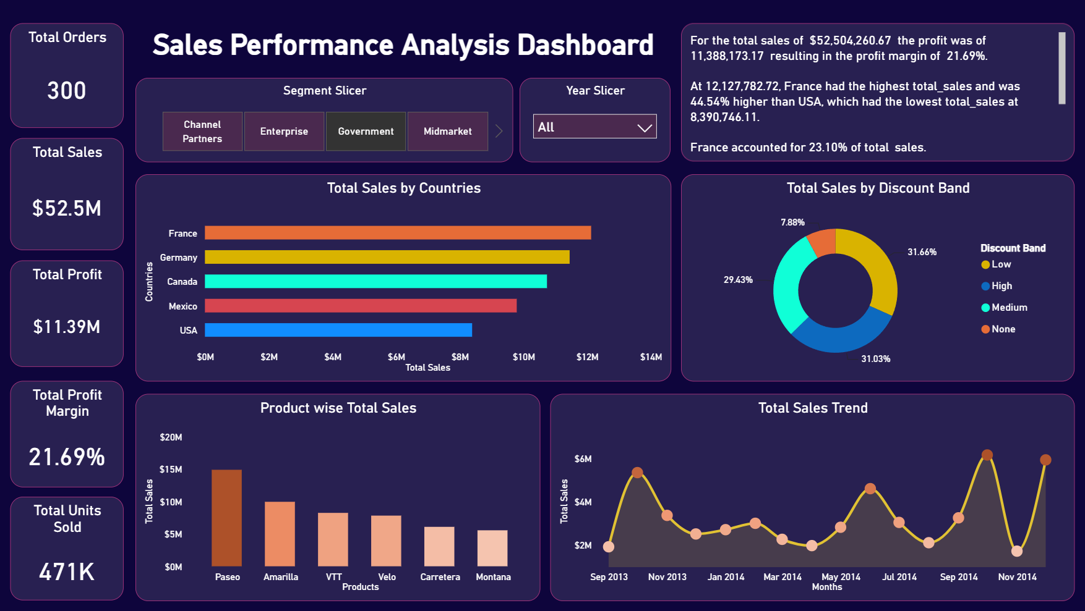
INSIGHT 02 Part 1
Government and Small Business Lead on Sales - Government
Segment filtering reveals which customer groups combine strong sales with strong profitability.
Government segment
Sales $52.5M | Margin 21.69%
05

Slide 6
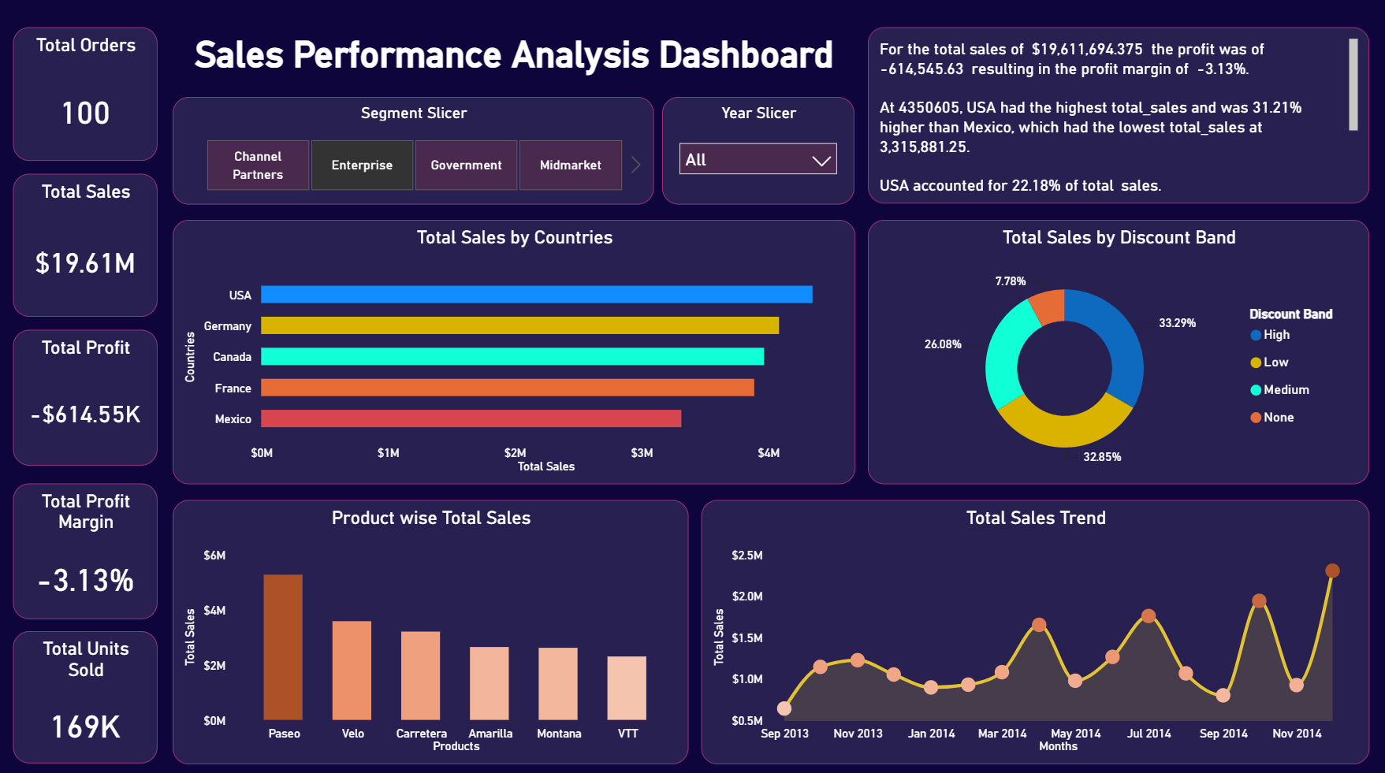
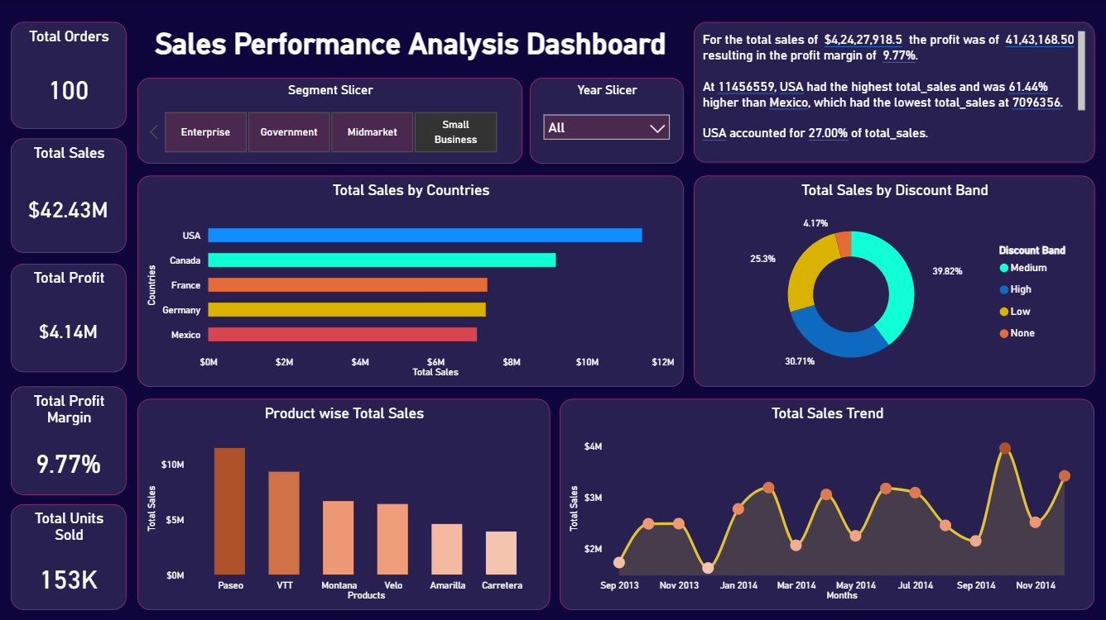
INSIGHT 02 Part 2
Government and Small Business Lead on Sales – Small Business
Segment filtering reveals which customer groups combine strong sales with strong profitability.
Small Business segment
Sales $42.43M | Margin 9.77%
06

Slide 7
INSIGHT 03
The Enterprise Segment Is Running at a Loss
Overall
$19.61M
-3.13%
loss of $614.55K
2013
$4.05M
-4.78%
loss of $193.76K
2014
$15.56M
-2.70%
loss of $420.79K
The loss margin narrowed from -4.78% in 2013 to -2.70% in 2014 — a sign of improvement, but the segment still needs cost control given how much sales volume it carries.
Enterprise segment, all years combined
07

Slide 8
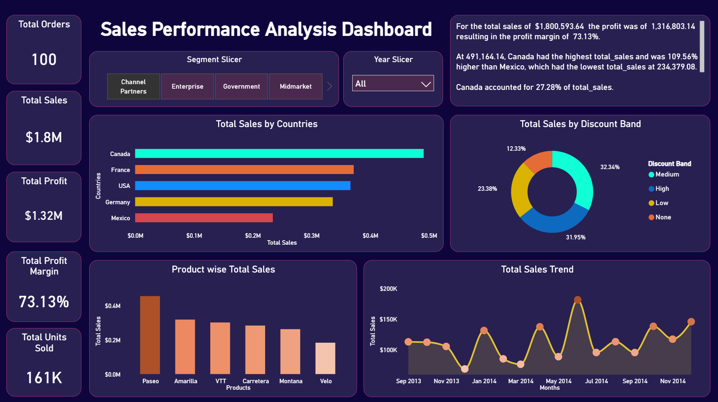
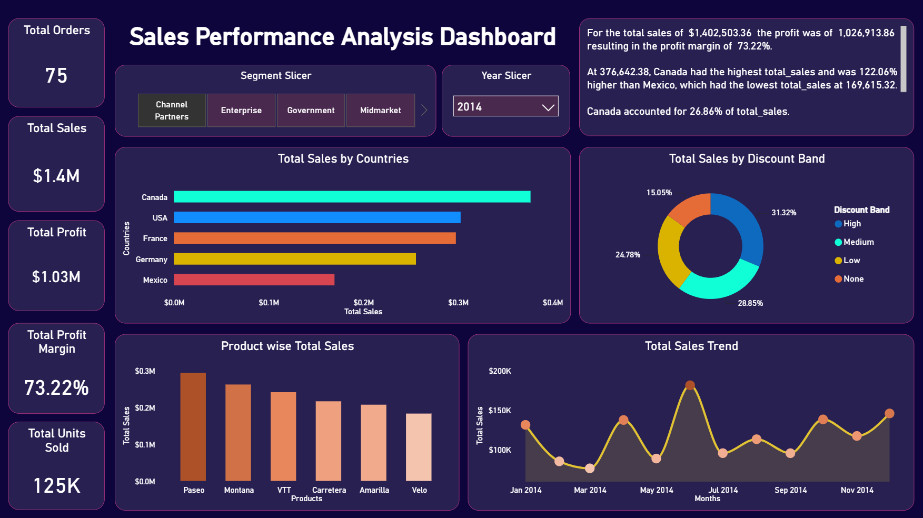
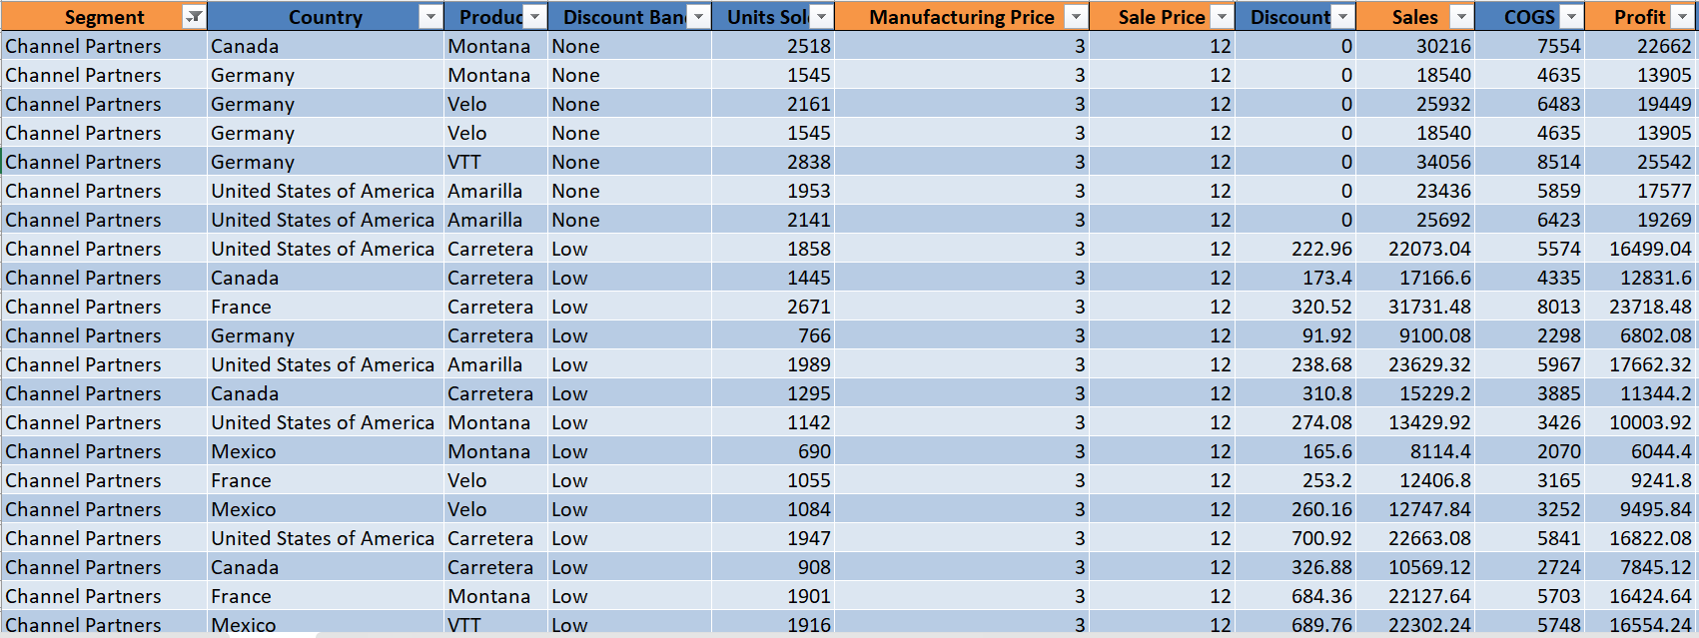
INSIGHT 04
Channel Partners Deliver the Highest Margin
$1.8M
$1.32M
73.13%
Total Sales
Total Profit
Profit Margin
Underlying record-level data (below) shows why: manufacturing cost for this segment is low relative to sale price, so even modest sales volume converts into strong profit.
Channel Partners, 2014 snapshot
08

Slide 9
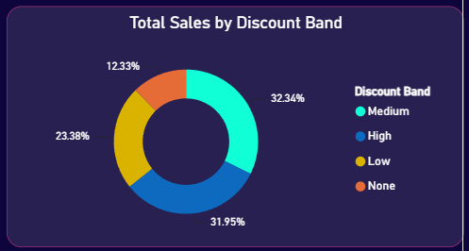
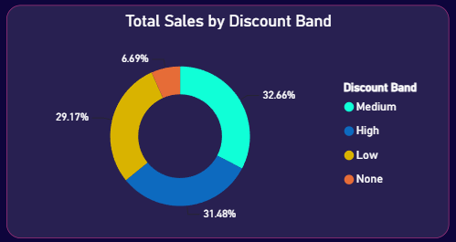
INSIGHT 05
Discounted Products Drive the Bulk of Sales
The “None” band consistently trails
Products sold without any discount made up only 6.69% of total sales here — the smallest share of all four discount bands, well behind Medium (32.66%), High (31.48%) and Low (29.17%).
What this means
This pattern holds across the dashboard — undiscounted products consistently add the least value to total revenue, which suggests discounting plays a real role in converting demand rather than just eating into margin.
Total sales by discount band, Channel Partners segment
09

Slide 10
RECOMMENDATIONS
Where to Focus Next
01
Promote the products Montana and Carretera through ad campaigns or targeted discounts to close the gap with the top-selling products.
02
Reduce manufacturing and other costs in the Enterprise segment — it carries a major share of total sales, so fixing its margin will create a great positive impact.
03
Invest in marketing for Channel Partners. Its profit margin is already the highest of any segment, so growing its sales volume is highly efficient.
04
Keep at least a low discount on products rather than none — undiscounted items consistently add the least value to total revenue.
10

Slide 11
THANK YOU
Questions & Discussion
Sales Performance Analysis Project Report • $118.73M total sales at a 14.23% profit margin
Prepared by Pranay

